Slide 1
IT Infrastructure and Support Systems

Slide 2
Outline
Data and Software Application Concepts
Types of Information Systems and Support
IT Infrastructures, Cloud Computing, and Services

Slide 3
Learning Objectives
Understand the types of information systems and how they process data.
Understand the types of information systems used to support business operations and decision makers.
Describe how IT supports supply chains and business processes.
Understand the attributes, benefits, and risks of service-based and cloud computing infrastructures.

Slide 4
Data and Software Application Concepts
Organizations have different types of information systems that collect and process data, distribute reports, and support decision making and business processes.
Starting with transactions that take place at an interface (e.g., withdrawing cash from an ATM), a transaction processing system (TPS) processes the data as follows:
verifies available funds
subtracts withdrawn amount updating the data in the database
Data are extracted from the database and organized into reports using management information systems (MIS).
Decision making is supported by decision support systems (DSS).

Slide 5
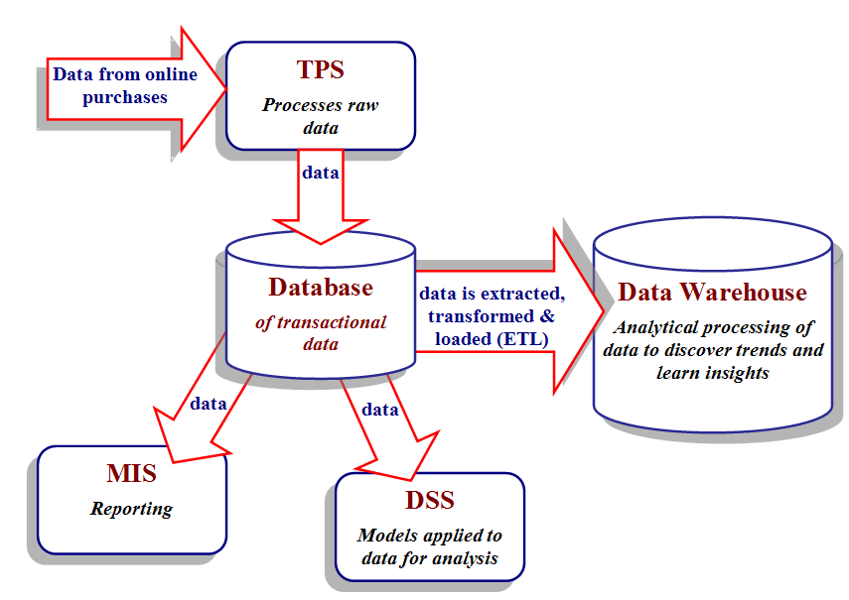
Figure 2.1 Diagram showing the relationships among information systems.
Various types of ISs and applications support managers, workers, work flows, business processes, and transactions with supply chain partners.

Slide 6
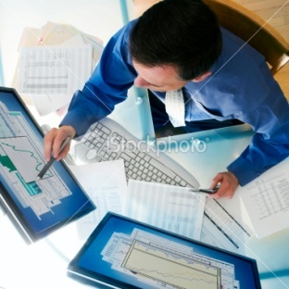
Data, Information, and Knowledge
Data: raw data
Database: stores data in such a way that it can be accessed, searched, retrieved, and/or updated
Information: data that’s been processed, organized, or put into context.
Knowledge: data or information that have been processed to convey understanding, experience, accumulated learning, and expertise as they apply to a current problem or activity.

Slide 7
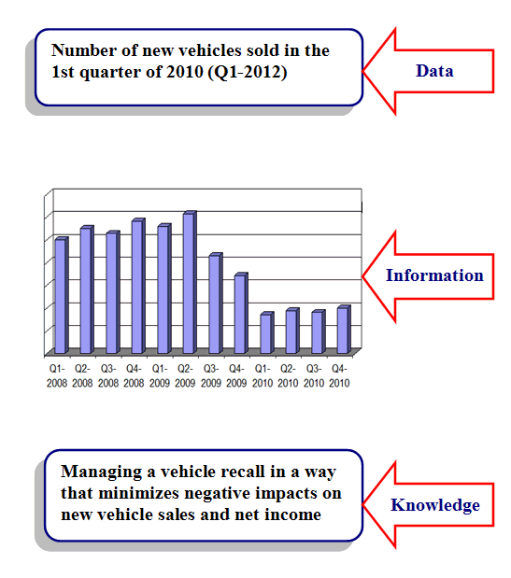
Figure 2.2. Example of data, information, and knowledge.

Slide 8
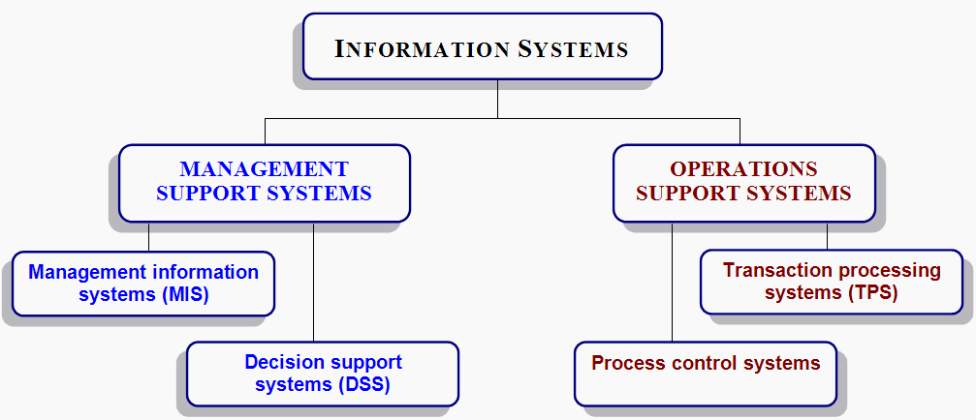
Types of Information Systems and Support
ISs classified into 2 categories based on type of support: management or operations

Slide 9
Layered Architecture
Model
View
Controller

Slide 10
Operations support system Transaction Processing Systems (TPS)
Data is processed by a TPS—e.g., sales orders, payroll, accounting, financial, marketing, purchasing, inventory control
Transactions are either:
Internal transactions: occur or originate from within the organization; e.g., payroll, purchases, budget transfers, & payments.
External transactions: originate from outside the organization; e.g., from customers, suppliers, regulators, distributors, and financing institutions.

Slide 11
Business Transactions in a Manufacturing Company
Payroll and personnel
Employee time cards
Employee pay and deductions
Finance and accounting
Financial statements
Accounts receivable / Accounts payable
Sales
Invoices and billings
Sales returns
Production
Production reports
Quality control reports
Inventory management
Material usage
Inventory levels

Slide 12
Operations support system Batch vs. Online Real-Time Processing
Processing of transactions is done in one of two modes:
Batch processing: The TPS collects all transactions for a day or other time period; and later processes the “batch” of transactions at once.
Online transaction processing (OLTP) or real-time processing: The TPS processes each transaction as it occurs, which is real-time processing.
OLTP requires that a network link the input device or Web site to the TPS.

Slide 13
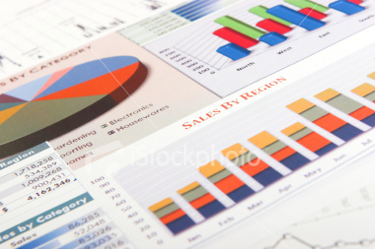
Management support system Management Information Systems (MIS)
General purpose reporting systems are referred to as management information systems (MIS).
3 types of reports
Periodic: created or run according to a pre-set schedule.
Exception: generated only when something is outside the norm.
Ad hoc: generated on an as needed basis.

Slide 14
Management support system Customer Relationship Management (CRM)
Manages all interactions with customers and provides platform for integrating customer in organization processes
3 characteristics of CRMSs:
easy-to-use interactive interface
Mange Lead – to – Cash lifecycle
Targeted marketing and communications

Slide 15
Management support system Customer Relationship Management (CRM)
Key Sales Components/processes
Organisations
Contacts
Leads (web-to-lead, email-to-lead)
Products
Prices
Opportunities
Quotations
Communications

Slide 16
Management support system Customer Relationship Management (CRM)
Customer Service
Organisations
Contacts
Cases
Email-to-case
Web-to-case
Escalation
Communications
Analytics

Slide 17
Management support system Decision Support Systems (DSS)
Support unstructured and semi-structured decisions, such as whether to make or buy products or what new products to develop & introduce into existing markets.
3 characteristics of DSSs:
easy-to-use interactive interface
models that enable sensitivity analysis, what if analysis, goal seeking, and risk analysis
data from internal databases, external sources, and added by the decision maker who may have insights relevant to the decision situation

Slide 18
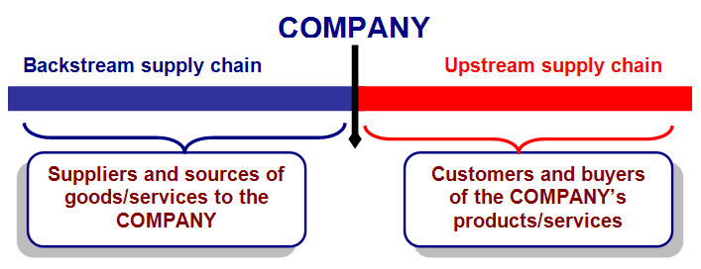
Supply Chain and Logistics Support
Figure 2.8 Backstream and upstream components of a supply chain.
A company’s competitive advantage—low cost, reliability, quality, or speed to market—depends on how well the supply chain is managed.

Slide 19
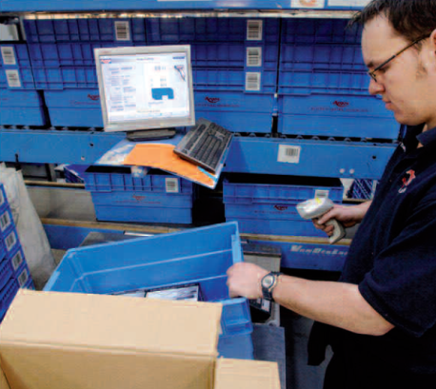
Logistics & RFID
Managing material and information flows to optimize supply chain operations.
Logistics has been described as having the right thing, at the right place, at the right time.
RFID (radio frequency identification) tags can be attached to or embedded in packages or physical objects.
RFID readers scan and input identifying information from the tags via radio waves.

Slide 20

Wal-Mart’s Global Sourcing Strategy for its Backstream Supply Chain
Because Wal-Mart has thousands of suppliers and constantly looks for new ones worldwide, they invested in a new global sourcing strategy.
Benefits:
reduced cost of goods to keep prices down
increased speed to market
improved product quality
Sourcing: identifying sellers (sources) that can provide Wal-Mart with products or services to sell in stores and online.
Global sourcing: purchase of goods or services from sellers located anywhere in the world.

Slide 21
2.4 IT Infrastructures, Cloud Computing, & Services
A company’s IT infrastructure determines the workload that its ISs, apps, and mobile computing devices can handle and their speed.
IT infrastructure: collection of hardware, software, processes, networks, and users.
IT infrastructure allows (and limits) the ability to store, protect, and manage data so that it can be made accessible, searchable, shareable, and actionable.

Slide 22
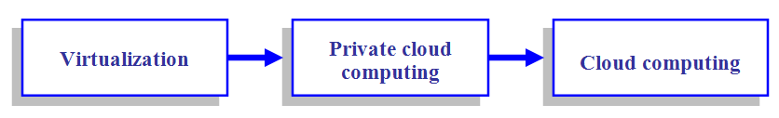
Cloud Computing
To improve performance at lower up-front costs, companies are turning to cloud computing.
Cloud: term used to refer to the Internet.
Cloud computing has greatly expanded the options for enterprise IT infrastructures.
Figure 2.10 Evolution to Cloud Computing

Slide 23

IT at Work
U.S. government spent about $68.1 billion in 2008 on IT, with 1/3 spent on IT infrastructure. Using cloud computing can significantly reduce costs and energy consumption.
U.S. Department of Defense (DoD):
implemented a private cloud to service many military agencies at reduced cost.
did not adopt (public) cloud computing because of the sensitive nature of their data.
U.S. Navy has drafted guidelines for ordering cloud services, but standards and policies for cloud computing have not yet been established.

Slide 24
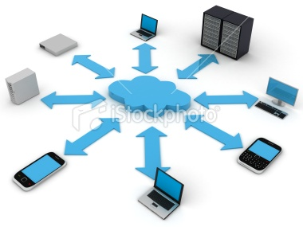
What Services are Available in the Cloud?
Software-as-a-Service (SaaS): popular IT model in which software is available to users as needed.
Other terms for SaaS:
on-demand computing
utility computing
hosted services
Basic idea: instead of buying and installing expensive packaged enterprise applications, users access software apps over a network

Slide 25
What Services are Available in the Cloud?
Platform as a Service
Build and deploy tailored
business applications on the cloud

Slide 26
Moving to the Cloud raises questions
Which workloads should be exported to the cloud?
Which set of standards to follow for cloud computing?
How to resolve issues of privacy and security as things move out to the cloud?
How will departments or business units get new IT resources? Should they help themselves, or should IT remain a gatekeeper?

Slide 27
Cloud computing limitations & trade-offs
Cloud computing runs on a shared infrastructure so the arrangement is less customized to a specific company’s requirements.
It’s more difficult to get to the root of performance problems, like the unplanned outages that occurred with Google's Gmail & Workday's human resources apps.
The tradeoff is cost vs. control

